Slide 1
Locators

Slide 2
Objectives
Build locators in Java
Find links on a page
Define XPath
Use Chrome to find elements

Slide 3
Overview
We are getting ready to write Selenium tests
In Selenium, you need to select the HTML elements
This can be done by a variety of methods
We will access the element through a driver
The driver links our Selenium to a browser

Slide 4
Use Chrome to get information on your elements
Open the webpage in Chrome
Right click the item you are interested in
Select Inspect, a element code window appears
Item is highlighted
The id, attributes… are visible.
The bottom shows the XPath tree, drop . Or #
Right click the element, copy – will give you an XPath element

Slide 5
Selenium test basic setup
//link the browser to Java
driver = new ChromeDriver; driver.get(“http://someWebPage.com”);
//select the objects
WebElement textbox = driver. findElement(By.name(“txtName”));
//send data
textBox.SendKeys(“Send some data”);
textbox.submit();
//test the response assertEquals(“value”, textbox.getText());

Slide 6
findElement Method
Searches the webpage for elements
Must provide the search criteria – uses the By object
By.type(“value”)
Type is how you are searching
Returns an element of type WebElement
If not found throws NoSuchElementFound exception
WebElement x = driver.findElement(By.id(“name”));

Slide 7
findElements Method
Returns a List of web elements
List <WebElement> inputs = driver.findElements(By.tagName(“input”));

Slide 8
By.types
id
name
className
tagName
linkText
partialLinkText
cssSelector
XPath

Slide 9
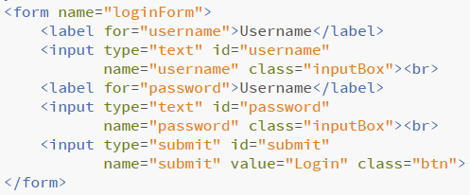
HTML Form

Slide 10
Find an element by ID
Find the username text box
WebElement tbox = driver.findElementB(By.id(“username”));

Slide 11
Find an element by tag
Find the username text box
WebElement tbox = driver.findElement(By.tag(“input”));
Will return the first
Can build a loop to walk through one at a time
Better to use findElements

Slide 12
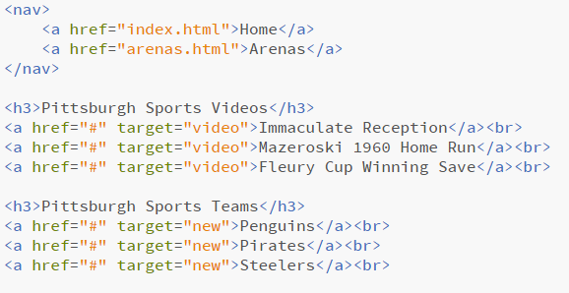
Sample Links

Slide 13
Find all links on the page
List <WebElement> aTags = driver.findElements(By.tag(“a”));
Walk through them
for(WebElement link : aTags){ //do something with the link }

Slide 14
Find a link by the full text
Find the link to the Steelers page
WebElement stl = driver.findElement(By.linkText(“Steelers”));
Will not find Steelers Immaculate Reception link

Slide 15
Find a link by the partial text
Find the link to both Steelers links
List <WebElement> steelerLinks = driver.findElements(By.partialLinkText(“Steeler”));
Will find all a tags with Steeler in the link
If you wanted only 2 Steeler tags, you could test with
assertEquals(2, steelerLinks.size());

Slide 16
HTML Form

Slide 17
Find elements by CSS class
We want to find the class=“btn” object on the form
WebElement btn = driver.findElement(By.className(“btn”));
btn.click()

Slide 18
Let us put text into our input classes
List <WebElement> inputs = driver.findElements(By.className(“input”));
for(WebElement textbox: inputs){ textbox.sendKeys(“Lee was here”); }

Slide 19
XPath
XML Path Language
Query language used to select nodes from an XML document
Technically HTML is a brother to XML
Browsers support DOM Level 3 XPath
Provides access to the DOM XML

Slide 20
XPath terms
Term | Description
Nodes | Any HTML tag
Atomic Value | Values on the page
Parents | Node above the current
Children | Node below the current
Siblings | Node at same level
Ancestors | Nodes above the current
Descendants | Nodes below the current

Slide 21
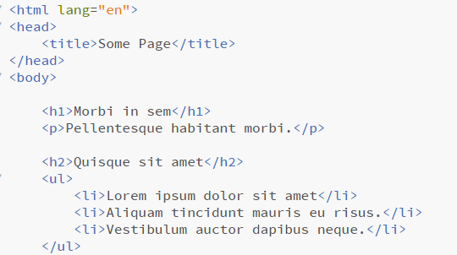
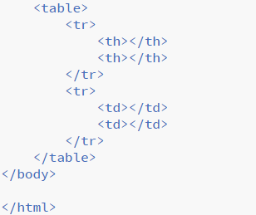

Slide 22
XPath example
HTML is the parent to all tags
Ul is the parent to all three li tags
Li tags are
Children to the ul
Siblings to each other
Tr, th, td are all descendants of table
Ul, body, html are ancestors of li

Slide 23
Selecting Nodes
Expression | Description
Nodename | Select all nodes with that name
/ | Select elements relative to root that match
// | Select all elements from the current node that match
. | Current node
.. | Parent of current node
@ | Attribute of a node

Slide 24
Find element using XPath
I will find the first tr tag in the table
WebElement tr = driver.findElement(By.xpath(“/html/body/table/tr”)’;
Find the first th, based on current location (first tr)
WebElement tr = driver.findElement(By.xpath(“//th”)’;

Slide 25
Use predicates
XPath predicates act like one based arrays
Find the third li tag
WebElement li3 = driver.findElement(By.xpath(“//li[3]”);
Find a text box with name of password
WebElement pwd = driver.findElement(By.xpath(“//input[@name=“password”);

Slide 26
Find page element using text
WebElement lorem = driver.findElement(By.xpath(“//li[contains(text(), ‘Lorem’)]”);

Slide 27
Use Chrome to get information on your elements
Open the webpage in Chrome
Right click the item you are interested in
Select Inspect, a element code window appears
Item is highlighted
The id, attributes… are visible.
The bottom shows the XPath tree, drop . Or #
Right click the element, copy – will give you an XPath element

